Slide 1
Quality schemes in
EU and RO
Lecturer dr. DANIEL CHICIUDEAN
Cluj-Napoca
2023

Slide 2
Quality schemes in EU

Slide 3
Main objectives
Introductory aspects;
The purpose of establishing a quality system;
Quality schemes for the agricultural/food products at European level;
Documentation required for certification;
Advantages of agricultural and food certification;

Slide 4
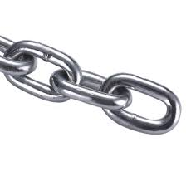
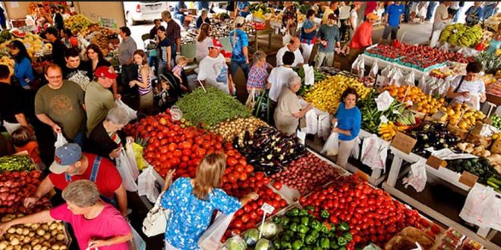
Short food chains
Short supply chain - selling from a farmer to a consumer by involving a small number of intermediaries;
Local agriculture - obtaining agricultural and food products in order to sell them in an area close enough to the crop / production area;
Local product.

Slide 5
Agricultural and food quality systems
Maintaining:
- cultural heritage
- gastronomic heritage
Of the UE taking into account new production methods and materials, as well as…

Slide 6
Agricultural and food quality systems
- Citizens and consumers in the Union increasingly demand quality as well as traditional products; - They are also concerned to maintain the diversity of the agricultural production in the Union.
=> This generates a demand for agricultural products or foodstuffs with identifiable specific characteristics, in particular those linked to their geographical origin.

Slide 7
The purpose of creating quality schemes
Correct information to consumers about the properties of products;
Fair competition between producers;
Integrity of the internal market;
Respect for intellectual property rights;
Increasing the level of health;
Pollution reduction.

Slide 8
EU agricultural and food quality systems
Protected Designation of Origin (PDO)
Protected Geographical Indication (PGI)
Traditional Speciality Guaranteed (TSG)

Slide 9
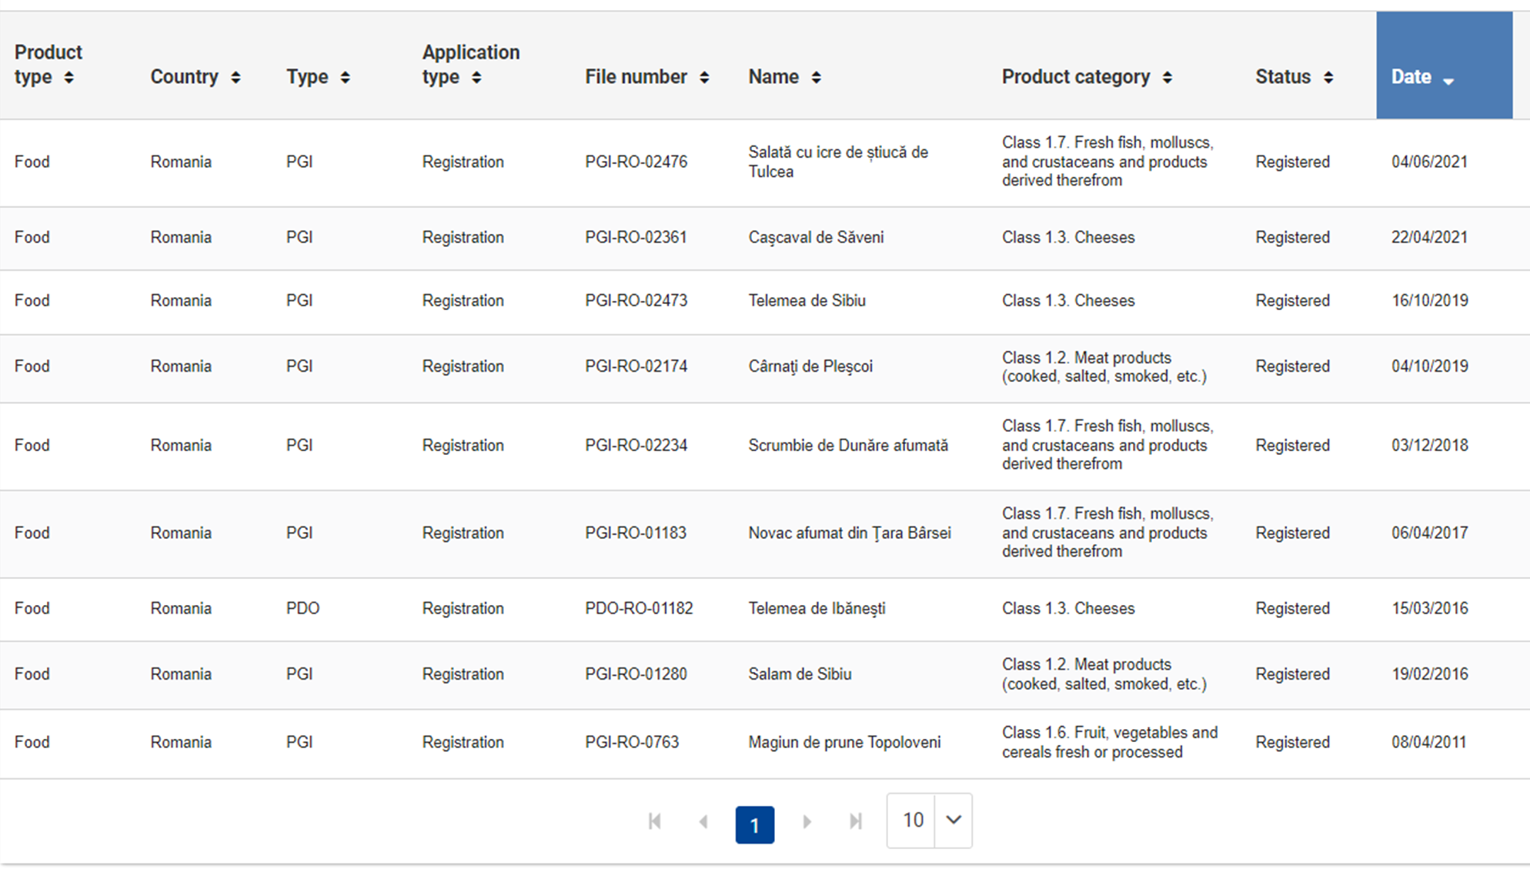
Romanian products certified according to EU quality schemes
Novac afumat din Țara Bârsei
Salam de Sibiu
Magiun de prune Topoloveni
Produsele pentru care s-a aplicat fără a fi încă înregistrate sunt:
Telemea de Sibiu
Cașcaval de Săveni
Magiun de prune Topoloveni
Cârnați de Pleșcoi
Scrumbie de Dunăre Afumata (urmează a fi înregistrată, fiind recent publicată).

Slide 10
Number of products certified at European level by Member States

Slide 11
Stages of obtaining certification
Establishing an association to promote the product;
- Preparation of a specification;
Inspection and certification body (OIC)
- Issues a certificate of conformity;
Transmission of the request to MADR;
-Verification of documentation 30 days;
- Publication of documentation;

Slide 12
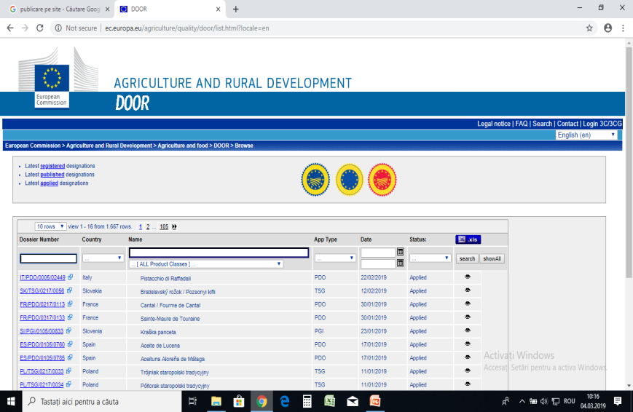
Stages of obtaining certification
Opposition period at national level - 60 days;
Granting national protection (DPN);
MARD sends the request to the European Commission
verification of documentation;
opposition period - 3 months;
Publication in the Community Register PDO and PGI.

Slide 13
Protected designation of origin
Regulation (EU) NO. 1151/2012 of the European Parliament and of the Council of 21 November 2012.

Slide 14
Protected Designation of Origin (PDO) requirements
originating in a particular place, region or, in exceptional cases, country;
whose quality or characteristics are mainly or exclusively due to a particular geographical environment with its own natural and human factors;
the production stages all take place in the defined geographical area.

Slide 15
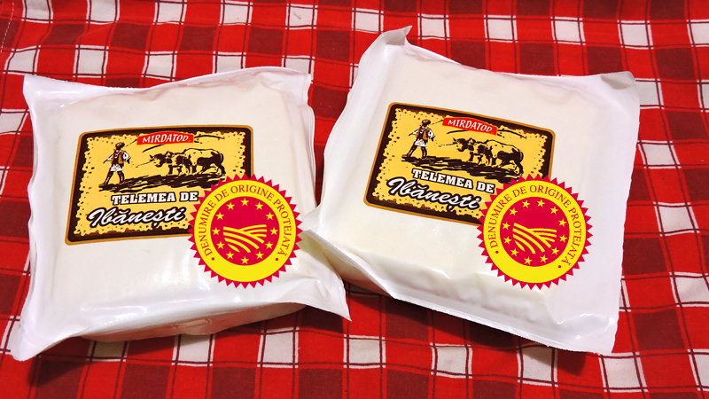
cheese specialty - milk obtained from the Gurghiului valley area, from cows grazing pastures with natural flora, specific to this area. - MIRDATOD S.R.L.

Slide 16
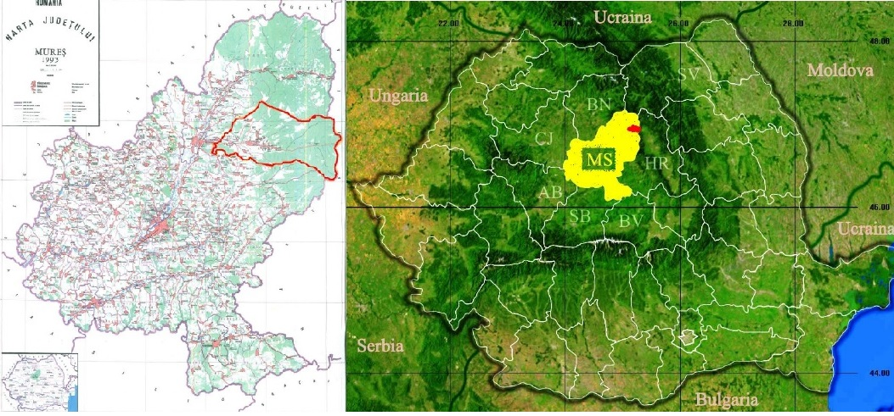
Produced only in Gurghiu, Hodac and Ibănești- Valea Gurghiului);
Salty - the salt water fountain from Orșova (higher amount of Ca and Mg in addition to Na, elements that are also found in the finished product);
Production method - passed down from generation to generation.

Slide 17
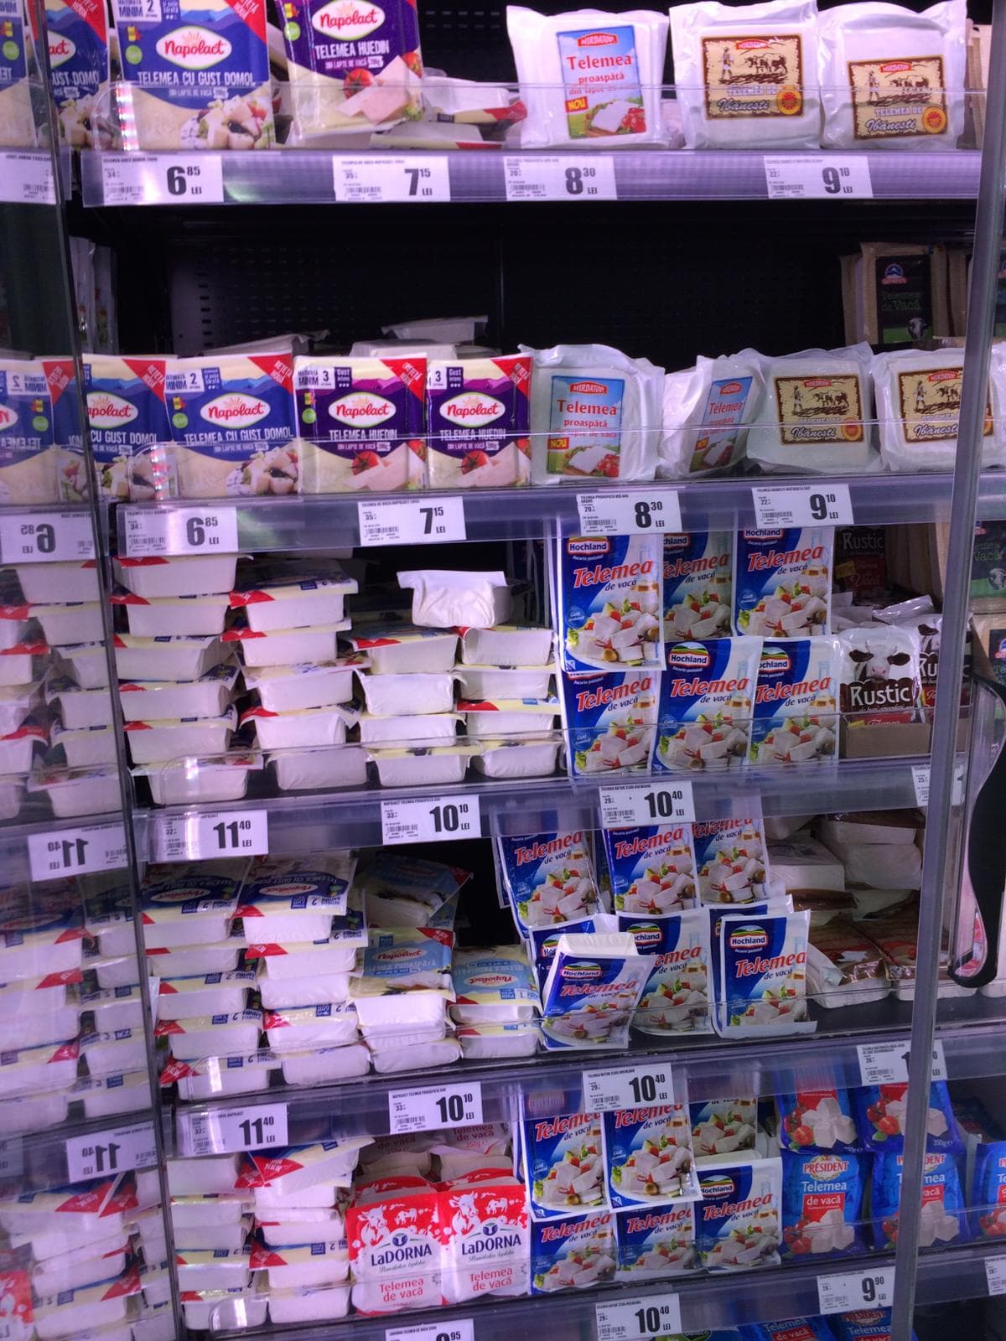
European opposition -"telemes"(Greek term - Greek nation).
Argument attestation of the word telemea from 1700;
State Archives;
National Library;
Faculty of Food Industry from Galați.
Creșterea notorietății la nivel european;
Piețe europene precum și în SUA;
Vizibilitate;
Prețul laptelui în zona valea Gurghiului 1,3-1,5 lei;
Creșterea numărului de exploatații în zonă;
Locuri de muncă – 100.

Slide 18
Protected geographical indication
Regulation (EU) NO. 1151/2012 of the European Parliament and of the Council of 21 November 2012.

Slide 19
Requirements for protected geographical indications (PGI)
originating in a particular place, region or country;
a certain quality, reputation or other characteristic may be attributed mainly to the geographical origin of the product;
when at least one of the production stages takes place in the defined geographical area.

Slide 20
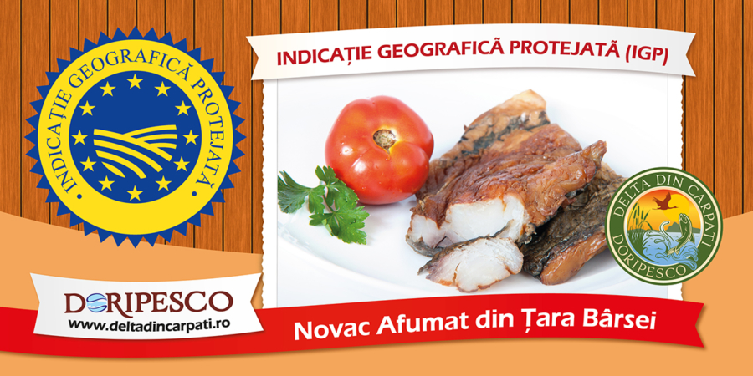
Smoked Novac from Ţara Bârsei
The processing is also done in the delimited geographical area, according to the local smoking recipe;
Novac fish is processed in the form of fillets, hot smoked with hard essence sawdust (beech) - unique flavor, the traditional method of smoking in the geographical area Țara Bârsei;
New sales markets: France, Germany, Austria and Italy.

Slide 21
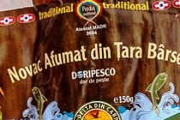
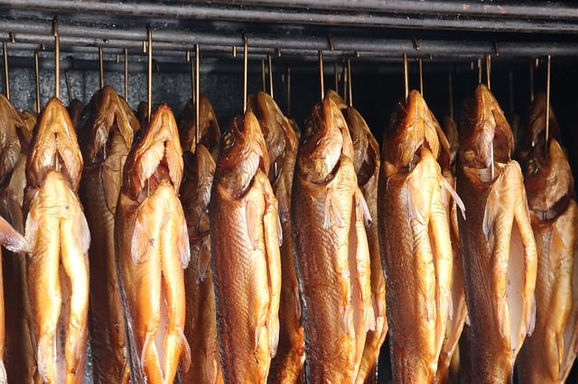
Smoked Novac from Ţara Bârsei
Novac is grown in the geographical area of ​​Ţara Bârsei, in ponds, lakes and ponds in the Olt meadow;
Reaches weight for processing in a longer period of time (3 years, compared to 2 years for novac grown in the plains);
The amount of fat is reduced by half compared to novac grown in the lowlands due to environmental conditions and low temperatures.

Slide 22
Content of the application for registration
Name and address of the applicant group and of the authorities / bodies verifying compliance with the specifications;
Specifications;
A document that contains:
main elements of the specification (name, product description, packaging / labeling, short delimitation of the geographical area)
description of the connection of the product with the geographical environment / geographical origin

Slide 23
Protection of registered names
Against products not covered by the registration;
Misuse, imitation or evocation;
False or misleading information concerning the origin, provenance, nature or qualities of the product;
Misleading practices regarding the true origin of the product.

Slide 24
Directions covered by PDO / PGI certification
to protect the natural resources of the production area;
to protect the landscape of the production area;
to increase the welfare of farm animals.

Slide 25
IMPORTANT!
A name may not be registered as a PDO or PGI if it coincides with the name of a plant variety or animal breed and may mislead the consumer as to the true origin of the product.
These quality systems do not apply to:
spirits;
aromatized wines;
wine products.

Slide 26
Financing solutions
Grants for quality schemes;
- through Sub-measure 3.1 “Support for the participation for the first time in quality schemes” of PNDR 2014
- 2020 developed through the Agency for Financing Rural Investments;
- 2021 - 8,108,739 euros.

Slide 27
Alte beneficii ale certificării
Economical - low transport costs.
Environmental:
reduction of exhaust emissions;
reduction of traffic congestion;
lower demand for rural roads.
Social - greater road safety.

Slide 28
Other benefits of certification
Supporting the rural economy (in disadvantaged areas, mountains, outermost regions) where production costs are high;
Contributes to the fulfillment of the objectives of the rural development policy;
Capitalization of the local / national dowry.

Slide 29
To remember!
Local food product
DOP characteristics
PGI characteristics
The advantages of certification

